Slide 1
Programming with Python
Days 13 - 15

Slide 2
Introduction to Google API
Google APIs is a set of application programming interfaces (APIs) developed by Google which allow communication with Google Services and their integration to other services. Examples of these include Search, Gmail, Translate or Google Maps. Third-party apps can use these APIs to take advantage of or extend the functionality of the existing services. (Wikipedia)
Google have created client libraries in various languages which allow developers to use Google APIs from within their code, including Java, JavaScript, .NET, Objective-C, PHP and Python.

Slide 3
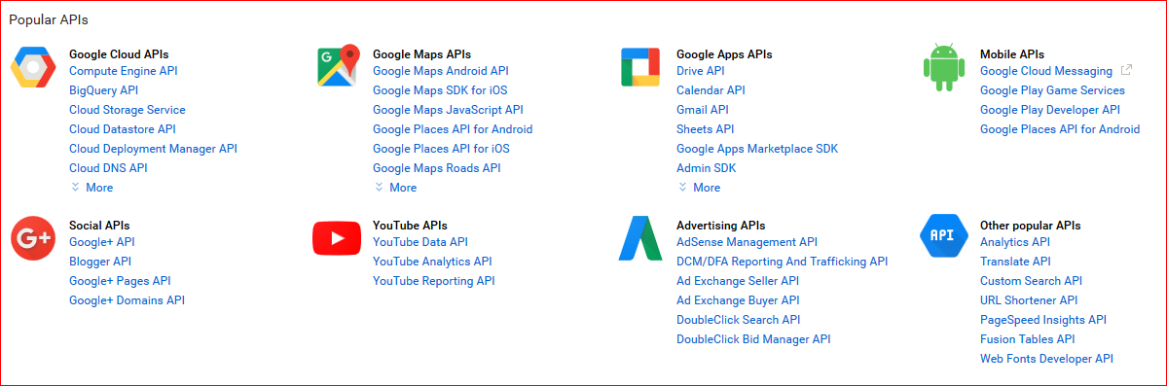
Introduction to Google API
Find all Google APIs at:
https://developers.google.com/apis-explorer/#p/

Slide 4
JavaScript Object Notation (JSON)
JSON is a syntax for storing and exchanging data.
JSON is language independent
It uses JavaScript syntax, but the format can be used with any interpreter or compiler that supports JSON
JSON is human readable and hierarchical
JSON evaluates to Objects and supports Arrays
Objects have properties
Example
{"employees":[ {"firstName":"John", "lastName":"Doe"}, {"firstName":"Anna", "lastName":"Smith"}, {"firstName":"Peter", "lastName":"Jones"} ]}
Google APIs exchange data in JSON format.
http://www.w3schools.com/js/js_json_intro.asp

Slide 5
JSON Syntax
Data is in name/value pairs
Data is separated by commas
Curly braces hold objects
Square brackets hold arrays
JSON values:
A number (integer or floating point)
A string (in double quotes)
A Boolean (true or false)
An array (in square brackets)
An object (in curly braces)
null
http://www.w3schools.com/js/js_json_intro.asp

Slide 6
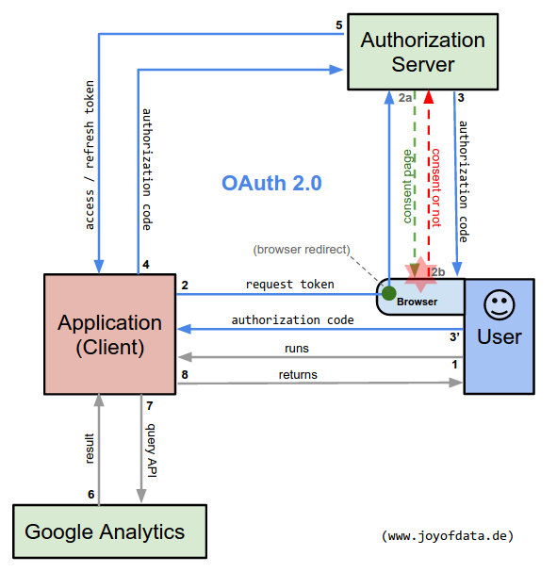
Open Standard for Authorization (OAuth)
Register the client application
Run the application
Google consent page opens in a browser
Authorization code
Access token
Refresh token
Store the tokens for future reuse.
http://www.joyofdata.de/blog/oauth2-google-api-python-google-analytics/

Slide 7
Getting Started with the Google API Python Library
Install Google API Python library by following these instructions:
https://developers.google.com/api-client-library/python/start/installation

Slide 8
Getting Started with the Google API Python Library
Follow the Google API Python Tutorial at https://developers.google.com/api-client-library/python/start/get_started
Create a Google Account
Create a Google Project
Install the Google API Python Library
Generate API keys for authentication and authorization
Build a Service Object
Retrieve the Collections
Google Books API example
Google Calendar API example
Review other Google API Python samples at https://github.com/google/google-api-python-client/blob/master/samples/README.md

Slide 9
Exercise
Your assignment for the remainder of the week is to come up with an idea for a Python application that uses Google API, then design, implement, test and present the working application. Examples:
Chart the movement, locations or directions using Google Maps
Create and manage a workflow using Google Tasks
Information search using Google Books
Digital photo frame using Picasa API
Use a Git repository for your Google API project
Work in teams of 2 people, where one can focus on Google API integration and the other on User Interface development.

Slide 10
Exercise
When you present your application to the class, emphasize the following:
What is original in your idea?
What is the potential value proposition of your idea?
What is your solution approach?
How did you structure the project (schedule, roles and responsibilities)?
How did you control the progress against schedule to meet the deadline?
What issues have you encountered and how have you resolved them?
It can be technical or non-technical issues
What have you learned from this exercise?
What would you do differently if you were given the same assignment again?
What have you done differently from other team(s), which approach is better and why?
It can be technical or non-technical aspect of the project.

